Slide 1
Habits
John Doe

Slide 2
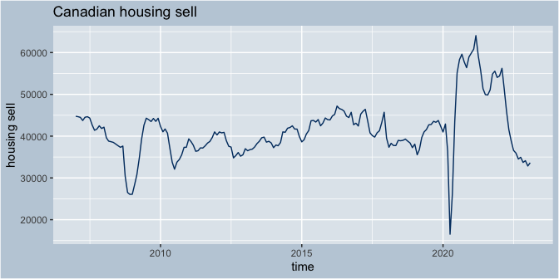
The Canadian housing market sell data seasonal adjust

Slide 3
Forecast in three different part
The forecast for all data
The forecast for the after 2008 finical crash
The forecast from 3 years before and after Covid pandemic
Further more

Slide 4
Breakfast
Eat eggs
Drink coffee

Slide 5
In the evening

Slide 6
Dinner
Eat spaghetti
Drink wine

Slide 7
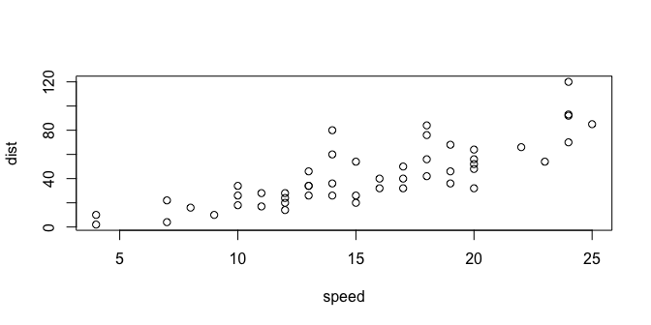
A scatterplot.

Slide 8
Going to sleep
Get in bed
Count sheep

